Slide 1
Alabama Children’s Policy Council Conference
Dr. Eric G. Mackey
October 27, 2022

Slide 2
Fundamental Questions
Every Child.
Every Chance.
Every Day.
Will it help our students become better readers?
Will it help our students be better prepared for success in Algebra?
Will it help our students become more productive, responsible citizens when they graduate and enter the workforce?

Slide 3
Alabama Achieves Strategic Plan
Academic Growth & Achievement
College, Career, & Workforce Ready
Safe & Supportive Learning Environment
Highly Effective Educators
Customer Friendly Services
ALABAMA STATE DEPARTMENT ^{of} EDUCATION

Slide 4
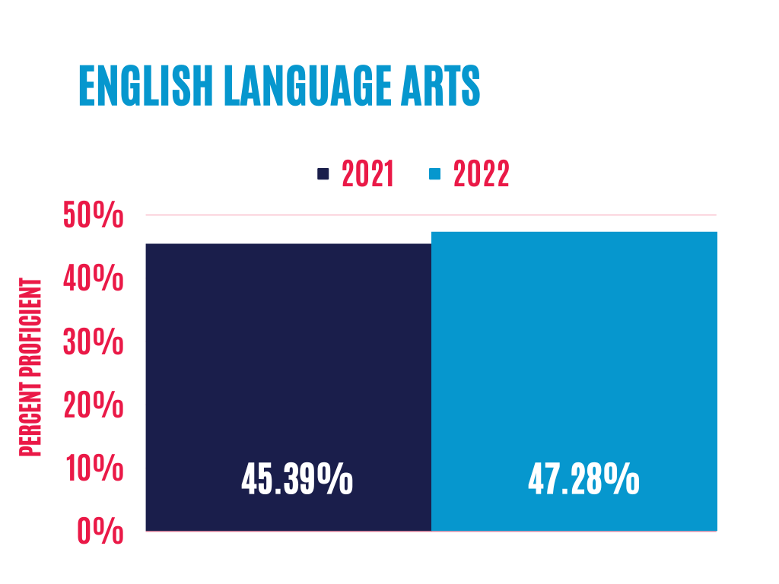
ACHIEVEMENTS
ACADEMIC GROWTH & ACHIEVEMENT
ACAP – English Language Arts

Slide 5
ACHIEVEMENTS
ACADEMIC GROWTH & ACHIEVEMENT
ACAP – Reading
3rd Graders Reading on Grade Level – Increased from 77% to 78%

Slide 6
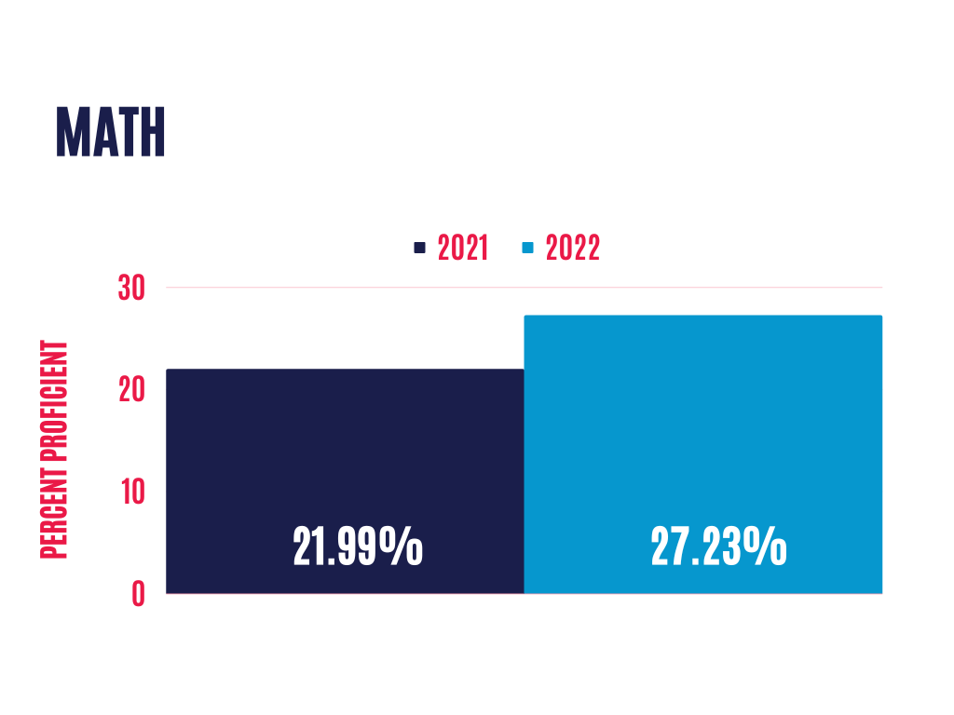
ACHIEVEMENTS
ACADEMIC GROWTH & ACHIEVEMENT
ACAP – Math

Slide 7
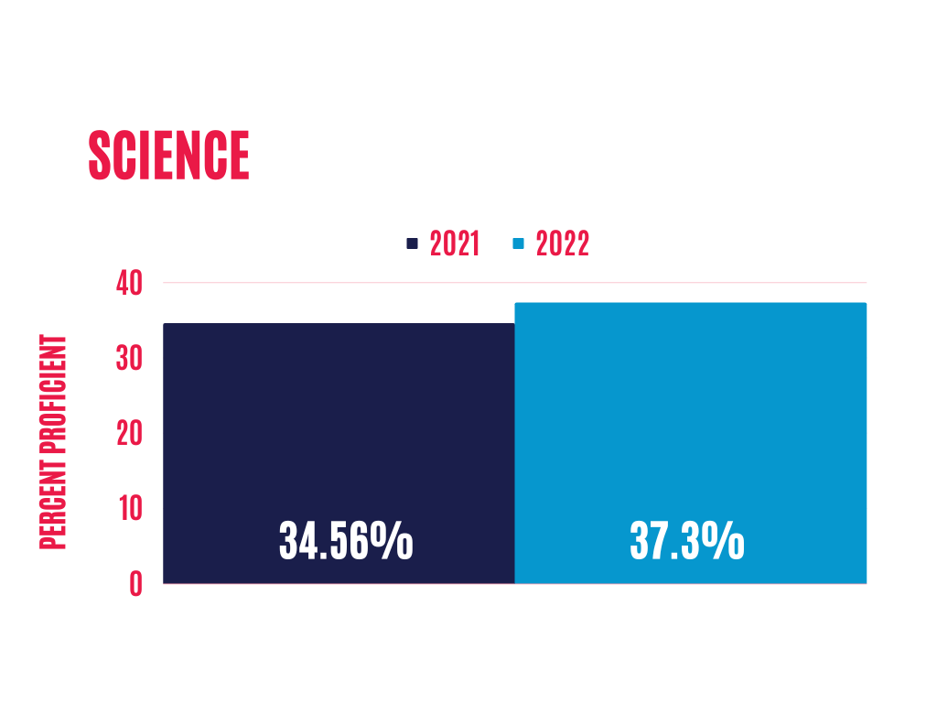
ACHIEVEMENTS
ACADEMIC GROWTH & ACHIEVEMENT
ACAP – Science

Slide 8
ACT with Writing – Juniors
ACT with Writing 2020-2021 and 2021-2022
Percentage of Students Tested by Proficiency Level and Total Percentage Proficient (Level 3 + Level 4)
 | Total Students Tested |  | Level 1 |  | Level 2 |  | Level 3 |  | Level 4 |  | Proficient (Level 3 + Level 4)
 | Spring 2021 | Spring 2022 | Spring 2021 | Spring 2022 | Spring 2021 | Spring 2022 | Spring 2021 | Spring 2022 | Spring 2021 | Spring 2022 | Spring 2021 | Spring 2022
ELA | 45,963 | 46,370 | 38% | 38% | 34% | 33% | 17% | 17% | 11% | 12% | 28% | 29%
Math | 47,159 | 47,850 | 47% | 48% | 30% | 29% | 16% | 16% | 8% | 8% | 23% | 23%
Science | 47,114 | 47,813 | 38% | 39% | 31% | 30% | 24% | 25% | 6% | 6% | 30% | 31%
ESSER 1
$216 Million
Spent by
Sept. 2022
 | 2020-2021 | 2021-2022
Average ACT State Composite Score | 17.2 | 17.3

Slide 9
College and career readiness
indicators

Slide 10
CCR Rates

Slide 11
CCR Indicators
Achieving a benchmark score on the ACT
Scoring a 3, 4, or 5 on an Advanced Placement exam3
Scoring a 4, 5, 6 or 7 on an International Baccalaureate exam
Scoring silver level or above on ACT Work Keys
Earning college credit while in high school
Earning an Industry Credential
Being accepted for enlistment into any branch of the military
Completing a CTE program of study
Completing an in-school youth apprenticeship
Other as determined by ALBOE

Slide 12
Middle School STEM Grants
Career Development Model
CTE Expansion

Slide 13
Teacher Retention & Recruitment Campaign

Slide 14
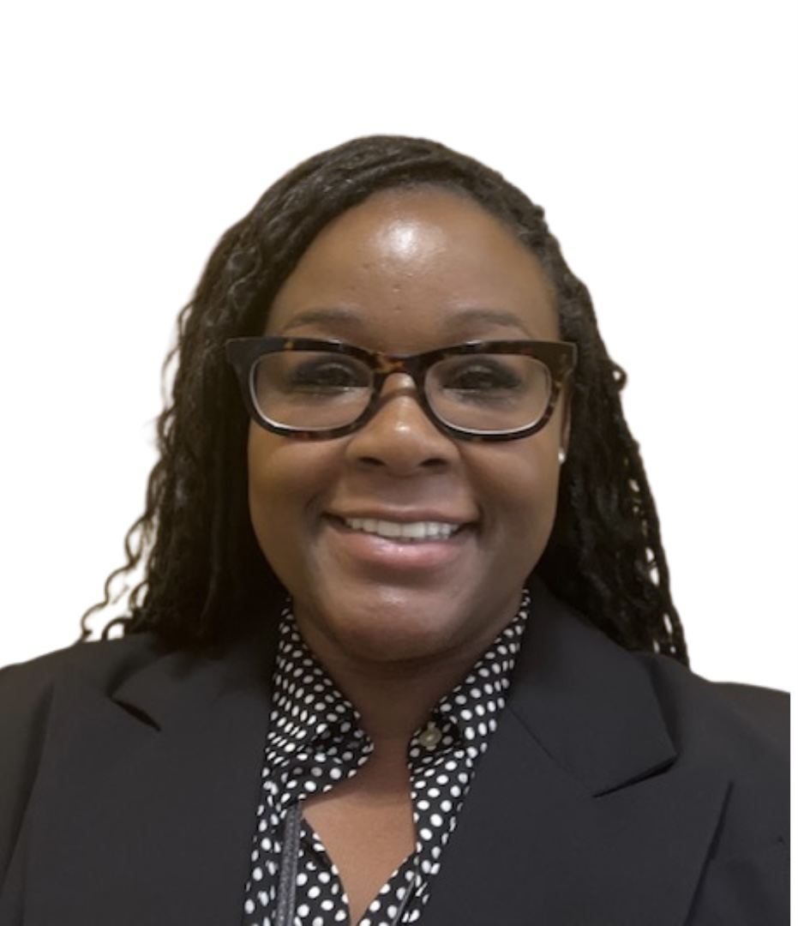
Recruiters
Kim Mitchell
Kimberly.Mitchell@alsde.edu
Mona Coan
Mona.Coan@alsde.edu

Slide 15
Retention – Thank AL Teachers Month
Extended to a Full month: November 1-30
Social, digital, print, & outdoor
Partnership with Nick’s Kids
Share videos thanking teachers
Recruitment – Real Influencers
First quarter of 2023
High School & College Students
Partnership with various Alabama Influencers
Social, digital, print

Slide 16
SAFE COUNCIL Update

Slide 17
SAFE COUNCIL UPDATE
PHYSICAL SECURITY
Funding for School Resource Officers (SRO’s) and District Safety Coordinators (DSC’s)
Bond Issue for Enhancing School Security
Surveillance Systems Linked to Law Enforcement
THREAT ASSESSMENTS & MENTAL HEALTH
School-Based Mental Health
Identify Warning Signs
Reporting Threats
Tracking School Violence
COORINDATED TRAINING & PLANNING
Empowered & Accountable District Safety Coordinators
Building a Culture of Safety
School Safety Training & Compliance Teams
Notes:
Physical Security:
Funding for School Resource Officers (SROs) and District Safety Coordinators (DSCs)
• SDE requires every school system required to name a designated DSC who attends SDE sponsored training 3 times per semester (all systems have one (some serve in multiple jobs though instead of full-time DSC)
• Every School system has some, not each school. Many law enforcement agencies and school districts split SRO expenses.
Bond Issue for Enhancing School Building Security Partially
• 2020 PSCA Bond provided $912m to K-12 schools for Capital Improvement Projects -- The PSCA bond in 2020 resulted in school security enhancements being allowable so long as they qualified as capital improvements. There has not been a bond dedicated to security.
• Advancement & Technology (A&T) Funds (allowable A&T expenditures)
Surveillance Systems Linked to Law Enforcement
Some already in place, but many school districts must upgrade their camera systems to allow for real-time connection to 911 centers
Threat Assessments & Mental Health:
School-Based Mental Health Fully
• School-Based Mental Health Collaboration Program currently has 91 school districts and 18 community mental health centers partnering to provide mental health services within school districts
• MHSC Program will provide a MHSC for every school district this fall
2. Identifying Warning Signs -- Allowable funding includes: • $250,000 for YMHFA training grants and • $3m Bullying Prevention Grants
• Our state has implemented the Colorado threat assessment model (referenced in the SAFE Report appendix) and ALSDE provides regular training
• Youth Mental Health First Aid (YMHFA) also provided
• Schools use various strategies and/or products to identify at risk students
3. Reporting Threats
Fully previously funded by ALEA, currently funded by ALSDE operating expenses, at risk, and upgraded with a federal grant
ALSDE partners with nSIDE, School Safety Platform, to create the Alabama Emergency Alert System for Education (AEASE).
Tracking School Violence
Every school system required to complete Student Incident Reports (SIRs) which allow ALSDE to track and report offenses throughout the year instead of annually Reporting also available through: • Suspicious Activity Report (SAR) with ALEA’s Fusion Center • nSide’s AEASE
Coordinated Training and Planning
Empowered and Accountable District Safety Coordinators
Every School System is required to name a designate DSC who attends SDE sponsored training 3 times per semester
Building a culture of Safety
Each school district required to have emergency operations plan
Each school required to annually train students and teachers on the emergency plan
Act 2021-424 required mental health awareness also be included in the annual training with school personnel
School Safety Training and Compliance Teams
Seven Regional School Safety Coordinators support their regions by conducting Threat Assessment trainings, school safety walkthroughs, YMHFA trainings, safety compliance monitoring, drill simulations, school safety best practices, etc.

Slide 18
Alabama
Achieves
Alabama State Department of Education
ALABAMA STATE DEPARTMENT ^{of} EDUCATION

