Slide 1
Children’s Policy Council Conference
Kimberly G. Boswell

Slide 2
Agenda
Access to Care
Infant and Early Childhood Mental Health
School-Based Mental Health
Child and Adolescent Mobile Crisis Teams
Alabama Crisis System of Care

Slide 3
Access to Care

Slide 4
Access to Care
988 Suicide and Crisis Lifeline Who Should Call
Connect Alabama App
As of July 16, 2022, 988 is the national three-digit number for all mental health, substance use, and suicide crises.
Direct connection to care for anyone in mental health-related distress.
Anyone who has a loved one who may need crisis support.
It is a behavioral health services and treatment finder application.
Provides instant access to education, information and treatment services.
A special feature is functionality even if Internet or data are not available.
Can be downloaded through the app store or Google play.

Slide 5
Infant and Early Childhood Mental Health

Slide 6
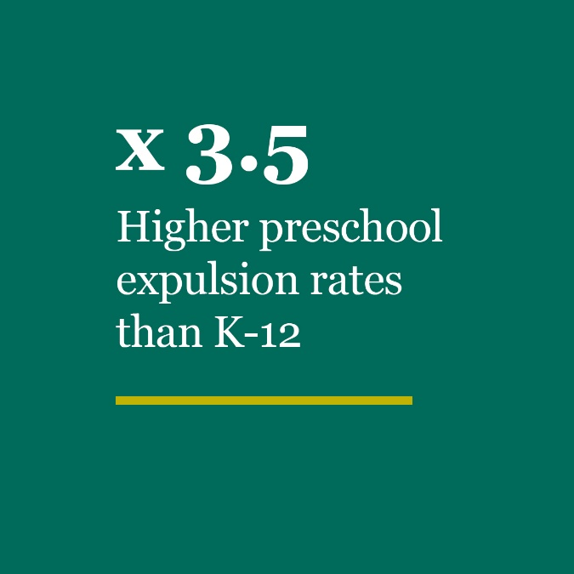
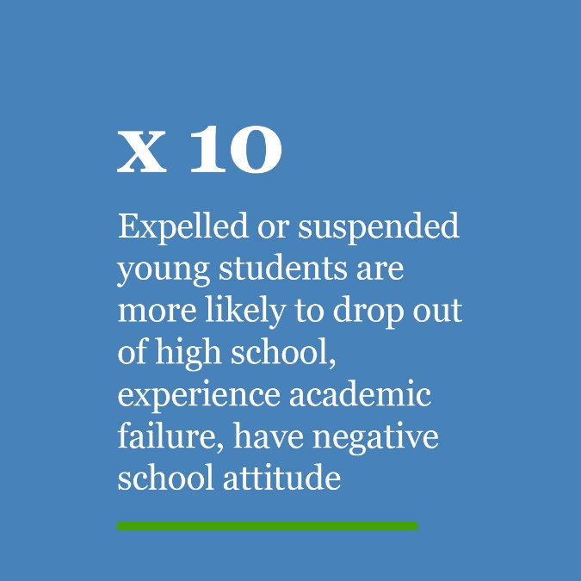
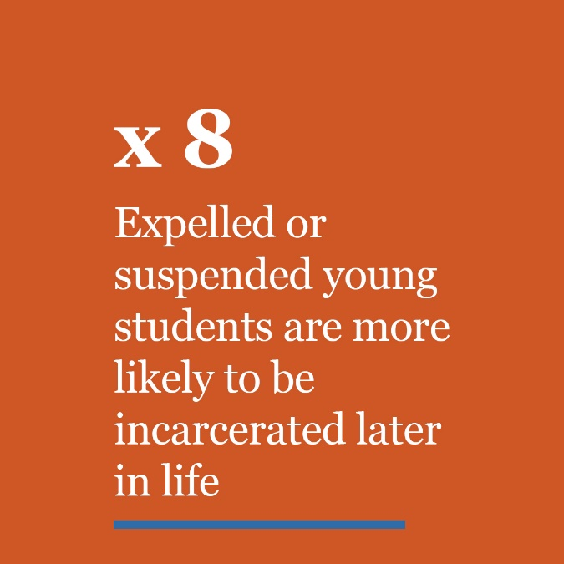
Experiences Early On Impact How Our Children Learn
We know which Children will Struggle by the
Time they are in Pre-K
Sources: Yale University Child Study Center, Journal of Educational Psychology, American Psychological Association
Notes:
Preschoolers are 3.5 times more likely to be expelled than children in K-12 combined; Expelled or suspended young students are 10x more likely to drop out of high school later on experience academic failure and have a negative attitude about school; Expelled or suspended young students are 8x more likely to be incarcerated later in life.

Slide 7
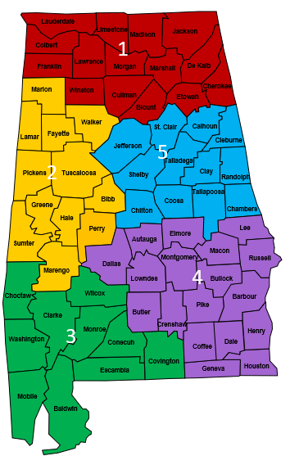
ADMH INFANT AND EARLY CHILDHOOD MENTAL HEALTH CONSULTATION
TWO CONSULTANTS
356 total classrooms
6,408 children
ONE CONSULTANT
150 total classrooms
2,754 children
TWO CONSULTANTS
334 total classrooms
6,066 children
ONE CONSULTANT
304 total classrooms
5,472 children
TWO CONSULTANTS
225 total classrooms
4,050 children
In First Class Pre-K, this translates into our Consultants impacting the lives of 21,384 4-year-old children served through the program.

Slide 8
School-Based Mental Health Collaborative

Slide 9
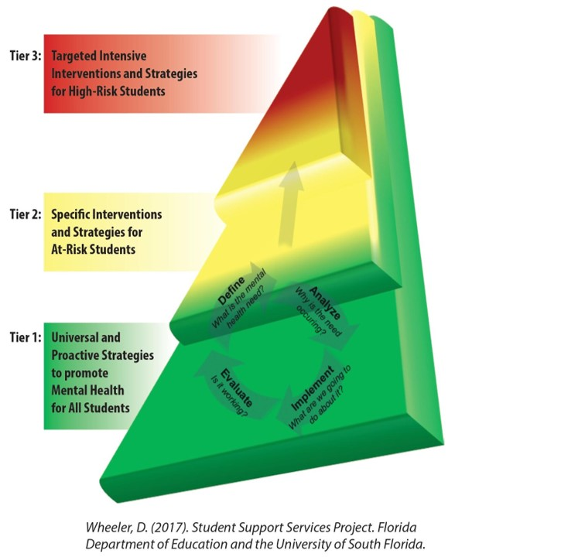
School-Based Mental Health
FY21 Update: Tiered Services

Slide 10
School-Based
Mental Health
Collaboration
20 sites not currently funded as part of the collaborative (10 new and 10 current)
80 school systems and 18 Community Mental Health Centers currently participate in the School-Based Mental Health Collaboration Program.
There are nine programs in progress for the 2021-2022 school year.

Slide 11
Child and Adolescent Mobile Crisis Teams

Slide 12
Services
Mobile Crisis Teams
Huntsville
Birmingham
Mobile
Pilot with a goal of funding expansion through a Medicaid State Plan Amendment
Emergency crisis intervention
Case management
Family engagement
Referrals

Slide 13
Alabama Crisis System of Care

Slide 15
Mobile Crisis Services

Slide 16
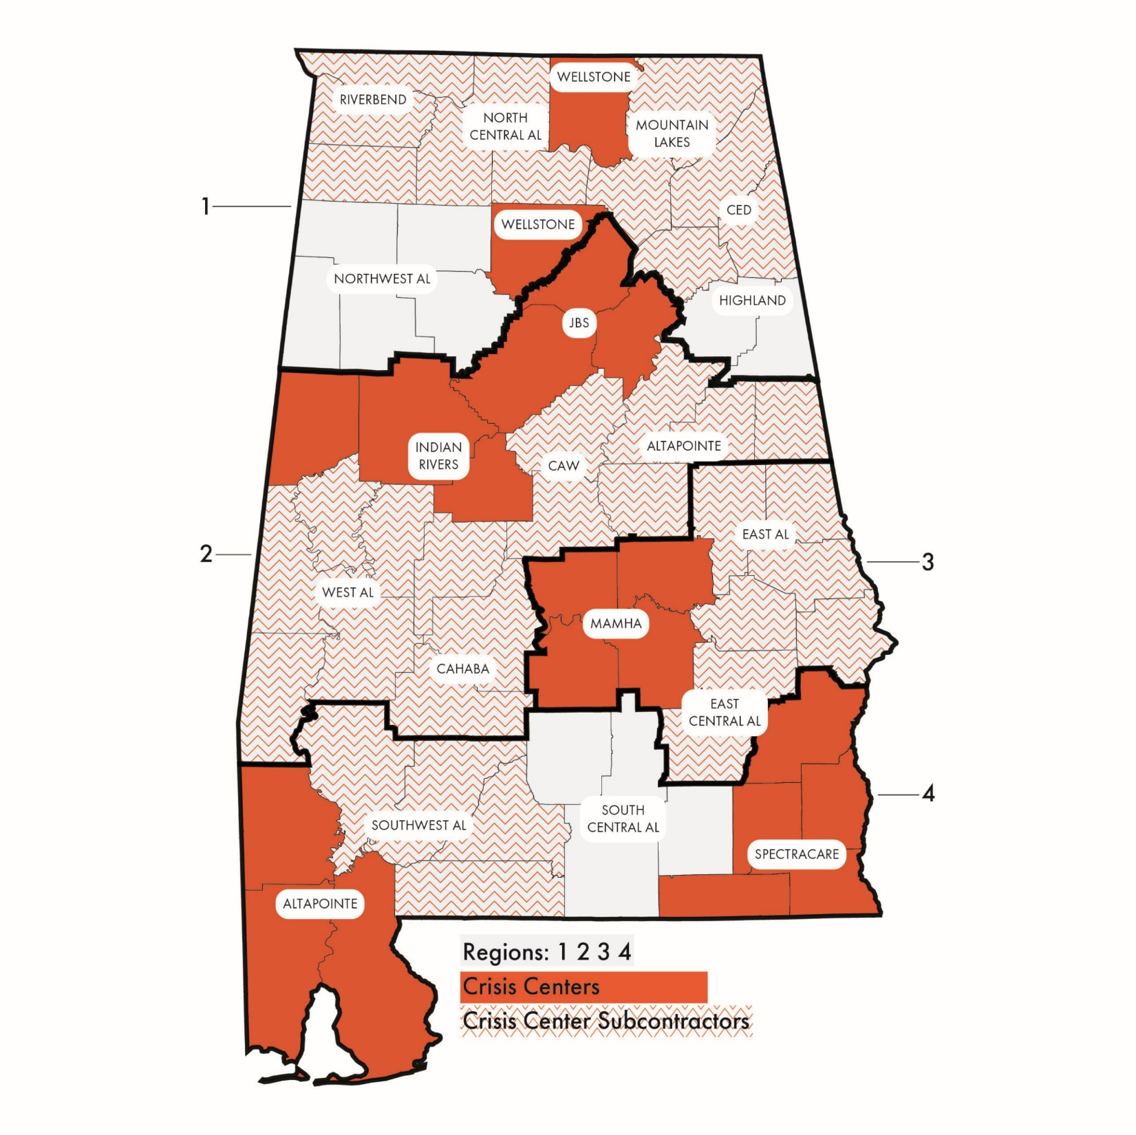
Crisis Centers in Alabama

Slide 17
The System Must Work Together

Slide 18
Strategic Priorities and Goals
System of Care & Partnerships
In coordination with our partners, provide integrated, prevention focused care so every Alabamian has access, without barriers, to services that meet their needs
Peer & Family Engagement
Benefit from the input and involvement of individuals and families through meaningful engagement and collaboration
Professional Workforce
Attract and retain a workforce that is highly qualified, diverse and stable
Organizational Health
Promote a work environment that emphasizes teamwork and prioritizes wellness, innovation, and a connection to mission
Knowledge & Awareness
Strengthen knowledge and increase awareness of ADMH so Alabamians have access to the resources and opportunities they need to be happier and healthier

Slide 19
Thank you
Kimberly G. Boswell
Commissioner
Alabama Department of Mental Health
kimberly.boswell@mh.alabama.gov
(334) 242-3640 | mh.alabama.gov

