Slide 1
Office of Juvenile Justice and Delinquency Prevention Title II Grant Program
Presented by :
Brian Forster, Program Supervisor
401 Adams Avenue, PO Box 5690
Montgomery, AL 36103

Slide 2
Purpose of Title II
The OJJDP FY 2022 Title II Formula Grants Program provides funding to support state and local efforts to plan, establish, operate, coordinate, and evaluate policies and projects, directly or through grants and contracts with public and private agencies for the development of more effective education, training, research, prevention, diversion, treatment, and rehabilitation programs in the area of juvenile delinquency as well as juvenile justice system improvement efforts.

Slide 3
HISTORY of Title II
Enacted in 1974 to provide a comprehensive, coordinated approach to prevent and address juvenile delinquency and improve the juvenile justice system
Established OJJDP to support local and state efforts

Slide 4
History of Title II
Created the Title II Formula Grants Program
Established the core requirements –
deinstitutionalization of status offenders (DSO)
separation of juveniles from adults in secure facilities (Separation)
removal of juveniles from adult jails and lockups (Jail Removal)
addressing disproportionate minority contact within the juvenile justice system (DMC) 1988
Reauthorized in 2002 as the JJDP Act of 2002
Changed “confinement” to “contact” in the DMC core
Reauthorized in 2018 in the Juvenile Justice Reform Act (JJRA) of 2018

Slide 5
Purpose of JJRA (Title II)
to support State, tribal, and local programs that:
prevent juvenile involvement in delinquent behavior;
promoting public safety by encouraging accountability for acts of juvenile delinquency; and
addressing juvenile crime through the provision of technical assistance, research, training, evaluation, and the dissemination of current and relevant information on effective and evidence-based programs for combating juvenile delinquency; and
to support a continuum of evidence-based or promising programs (including delinquency prevention, intervention, mental health, behavioral health and substance abuse treatment, family services, and services for children exposed to violence) that are trauma informed, reflect the science of adolescent development, and are designed to meet the needs of at risk youth and youth who come into contact with the justice system.

Slide 6
Use of Title II Formula Grants Program Funds
66 2/3 % of funds received by the State under section 11132 of this title shall be expended –
through programs of units of local government or combinations thereof, to the extent such programs are consistent with the State plan;
Through programs of local private agencies, to the extent such programs are consistent with the State plan, except that direct funding of any local private agency by a State shall be permitted only if such agency requests such funding after it has applied for and been denied funding by any unit of local government or combination thereof; and
to provide funds for programs of Indian tribes that agree to attempt to comply with the core requirements applicable to the detention and confinement of juveniles, an amount that bears the same ratio to the aggregate amount to be expended through programs referred to in subparagraphs (A) and (B) as the population under 18 years of age in the geographical areas in which such tribes perform such functions bears to the State population under 18 years of age

Slide 7
Formula Grants Program Areas
Addressing the Needs of Girls (V)
Aftercare/Reentry (R)
After-School Programs (Q)
Alternatives to Detention and Placement (A)
Child Abuse and Neglect Programs (D)
Diversion
Compliance Monitoring and TTA to Secure Facilities (W)
Deinstitutionalization of Status Offenders
Disproportionate Minority Contact
Jail Removal
Separation of Juveniles from Adult Inmates
Learning and Other Disabilities (I)
Legal Representation for Juveniles (G)
Mental Health or Co-occurring Disorder Services (T)
Mentoring, Counseling, and Training Programs (H)
Planning and Administration
Positive Youth Development (L)
Delinquency Prevention (C)
Gangs (J)

Slide 8
Formula Grants Program Areas
Graduated and Appropriate Sanctions (M)
Hate Crimes (P)
Indian Tribe Programs
Indigent Defense (G)
Job Training (H)
Juvenile Justice System Improvement
School Programs (E)
Strengthening Families (B) (N) & (O)
Probation (F)
Protecting Juvenile Rights (S)
Records Expungement and Sealing (U)
Reducing Probation Officer Caseloads
Rural Area Juvenile Programs
State Advisory Group Allocation
Substance and Alcohol Abuse (K)

Slide 9
Promising Programs
https://ojjdp.ojp.gov/model-programs-guide/all-mpg-programs
https://www.samhsa.gov/
https://crimesolutions.ojp.gov/

Slide 10
Examples of Successful Programs

Slide 11
Extended Family for Kids
Cherokee County
Extended Family for Kids (EFK) is an evidence-based curriculum for children with loved ones incarcerated.
Students grades K-12 experience 9 interactive lessons teaching them how to make good choices today and in the future.
Students shed the stigma associated with family incarceration.
"14 Stress Busters", how to deal with bullying, and ways to express anger without getting in trouble.
They create a positive relationship with a police officer, resulting in improved trust of law enforcement.

Slide 12
Extended Family for Kids
Extended Leadership Academy, provides high school students 18 lessons in job readiness, health, and communications.
EFK Programs will reach students in three Alabama school systems.
EFK Programs will also be led in three juvenile offender programs, in Cherokee, Etowah and DeKalb Counties.

Slide 13
Extended Family for Kids
Goals
Increase enrollment in Extended Family for Kids (EFK) and 2nd-step EFK Program, Extended Leadership Academy (ELA) by 15% over the same period last year.
Lead Extended Family for Kids (EFK) Programs in three school systems (Cherokee, Etowah, Calhoun Counties).
Lead Extended Family for Kids (EFK) Program Groups in three Juvenile Offender Programs.
88% of students meet EFK Lesson Goals, of students in EFK Program Groups Oct. 1, 2021 – Sept. 30, 2022.

Slide 14
Morgan County System of Services
Morgan County System of Services (SOS) endeavors to divert juveniles from deeper penetration into the juvenile justice system.
some juveniles do commit serious crimes for which they are ordered to out-of-home placement.
For these juveniles, there is a compelling need to provide re-integrative services that prepare these extremely high-risk juveniles for reentry into the community and reduce recidivism.

Slide 15
Morgan County System of Services
Without systematic planning for reentry to assist juveniles in out-of-home placements to transition successfully back to their communities, these youth are at increased risk of further involvement with the juvenile justice system.
SOS proposes to further reduce recidivism among this target population by providing a Juvenile Reentry Transitional Program to bridge the gap between the juvenile's discharge from an out-of-home placement and return to the community.

Slide 16
Morgan County System of Services
Goals
Strengthen and improve the Morgan County Juvenile court System and reduce disproportionate minority contact by addressing the underlying causes of juvenile recidivism to assist high-risk youth returning from out-of-home placement and their families to reduce risk factors and increase protective factors.
Provide the critical services, resources and opportunities to enable boys in the transitional residential reentry program to effectively address identified issues and problems and improve their chances to successfully return to their families, avoid committing new crimes and transition into adulthood.

Slide 17
Morgan County System of Services
Goals
Strengthen family relationships and encourage families to provide stable home environments for these boys.
Facilitate the reunification of boys enrolled in the transitional residential reentry program with their families or refer them to other appropriate alternative safe and appropriate housing.
Assist each boy to develop an individualized plan for successful reentry.

Slide 18
Tuscaloosa One Place
Championing Successful Futures program supports Tuscaloosa County youth and families by serving 20 youth and parent/guardians through the evidence based programs, Triple P Positive Parenting and Why Try.
strengthen families and youth in the home or returning from out of home placements through educating youth and families through Triple P Positive Parenting and Why Try programs.
Implementation of these curricula has improved parent/child relationships, increased parental involvement, improved decision making skills, and increased resiliency in youth and families thus decreasing delinquency, risky behaviors, and recidivism.

Slide 19
Tuscaloosa One Place
Although the Tuscaloosa County Juvenile Court is the primary referral source for this program, our agency also works with other partners including Tuscaloosa County DHR, Tuscaloosa City and Tuscaloosa County Schools and other social service agencies to identify youth and families who can benefit from this program.

Slide 20
Tuscaloosa On Place
Goals
Strengthen youth and families, while keeping youth in the home and diverting current and future court involvement through two-three months of education sessions and case management
Create a safe environment for youth and families through two-three months of education and in-home case management support.

Slide 21
Tuscaloosa One Place
Goals
Educating 20 parents/guardians through the Triple P Positive Parenting curriculum and the Why Try curriculum.
Reduce risk factors in 80% of program families and increase protective factors in 80% of program families as measured by the Protective Factors Survey.

Slide 22
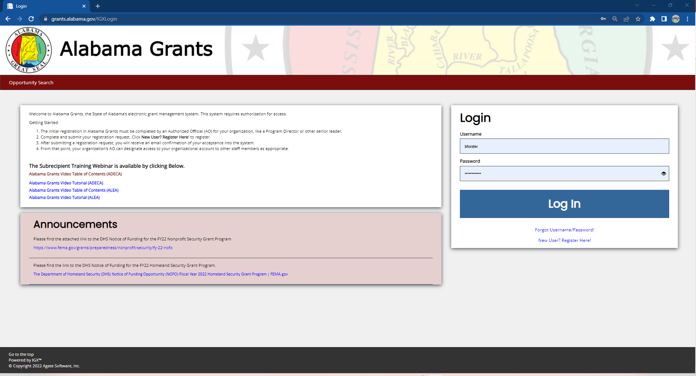
Alabama Grants
https://grants.alabama.gov/IGXLogin

Slide 23
Alabama Grants
https://shared.agatesoftware.com/IGX_ALSTATE/IGXLogin/Index?ReturnTo=%2FIGX_ALSTATE%2FDashboard

